Slide 1
Architecture
Server – Client architecture

Slide 2
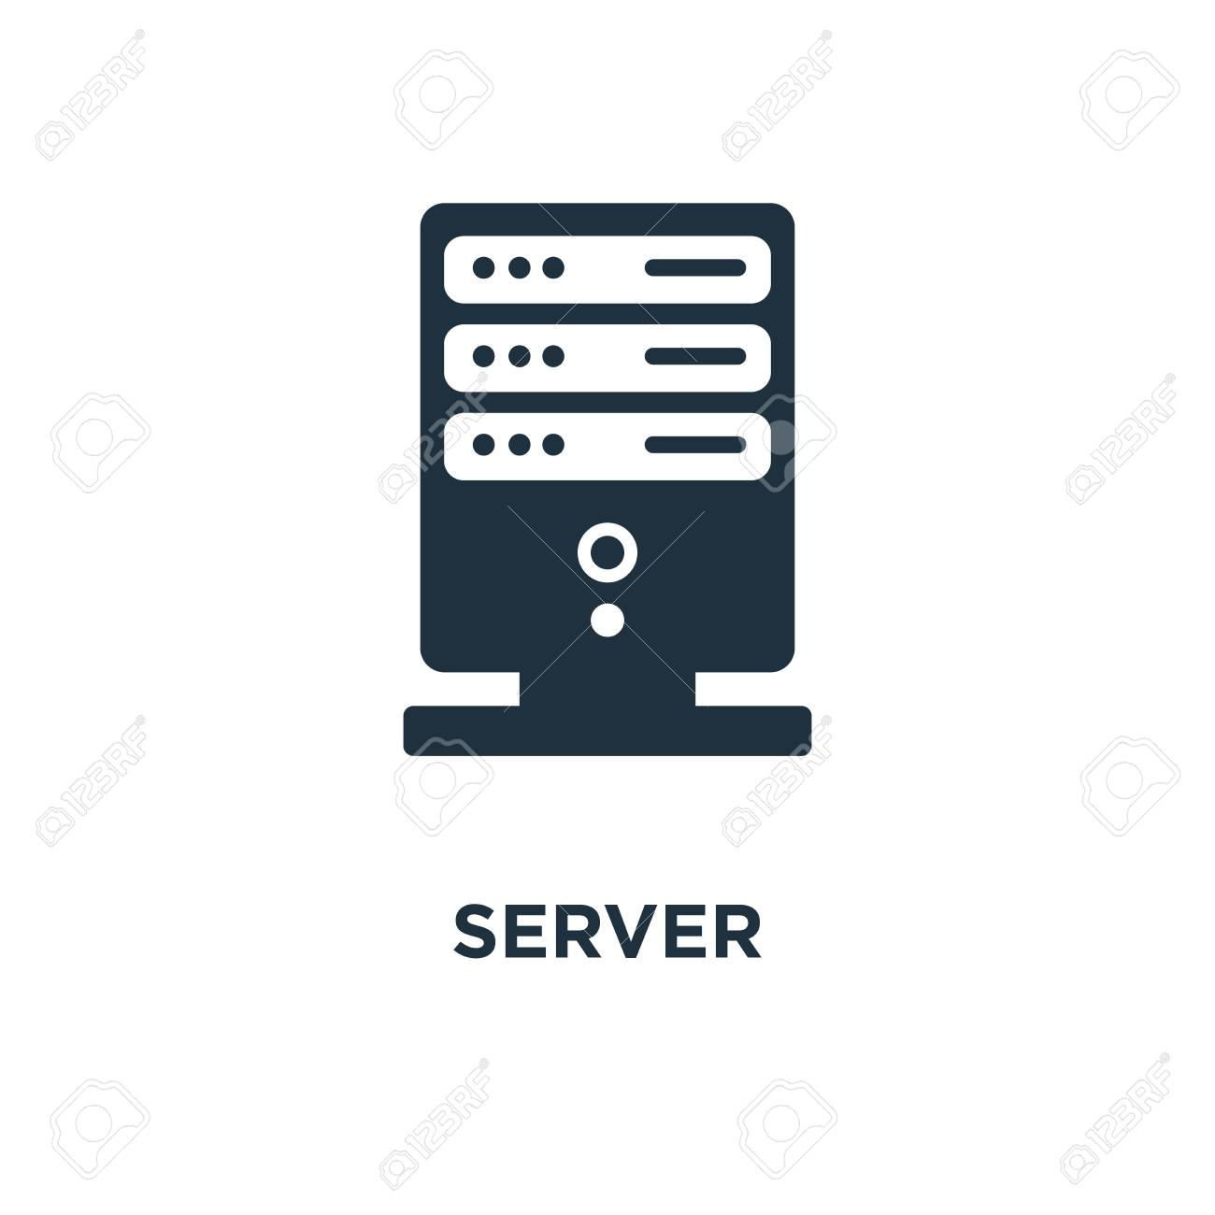
Server – Client
Server
Mobile browser
HTTPS
Desktop client
INTERNET
HTTPS
HTTPS

Slide 3
Hosting
At “Heroku” JSP server – hosted on Amazon’s data center, located in North America
Database
Central Database: Postgres provide by “Heroku” placed on Amazon’s data center
Benefit
Minimizing time on database setup and maintenance
Allowing server quickly access data
Security and privacy
- Only development team have full access to application level and database level
Two side encrypted password (DB and on communication)
Only shop owner can see customer information

Slide 4

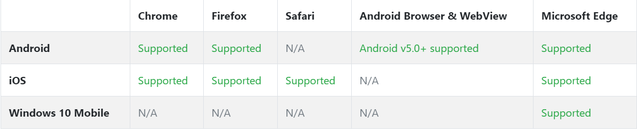
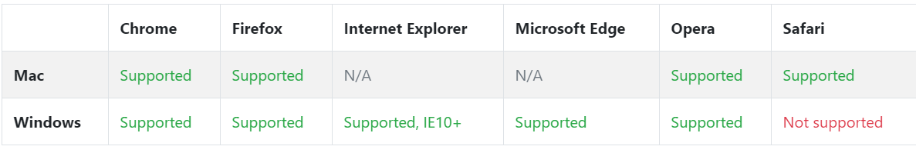
Connectivity
Must have internet connection
Mobile browser
Desktop browser
Client
Source: https://getbootstrap.com/docs/4.0/getting-started/browsers-devices/

Slide 5
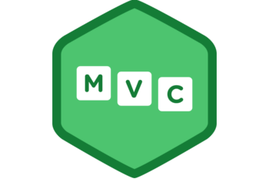
Model pattern
MVC – Model View Controller pattern

Slide 6
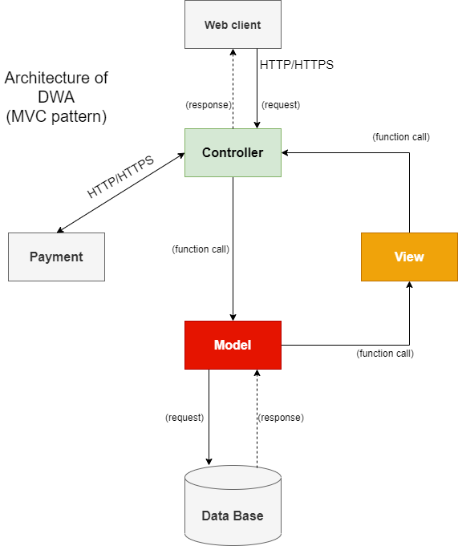
MVC model

Slide 7
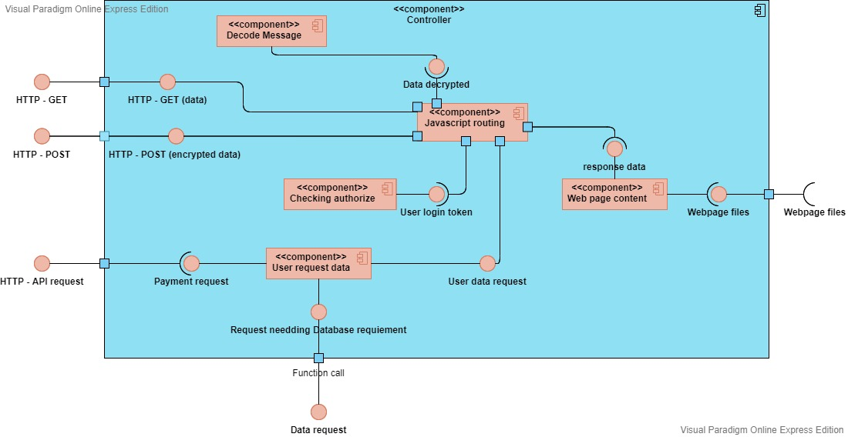
MVC (Controller)

Slide 8
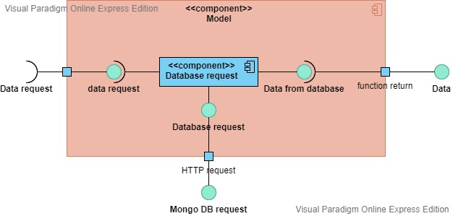
MVC (Model)

Slide 9
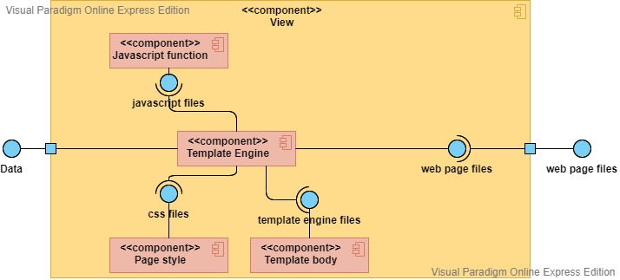
MVC (View)

Slide 10
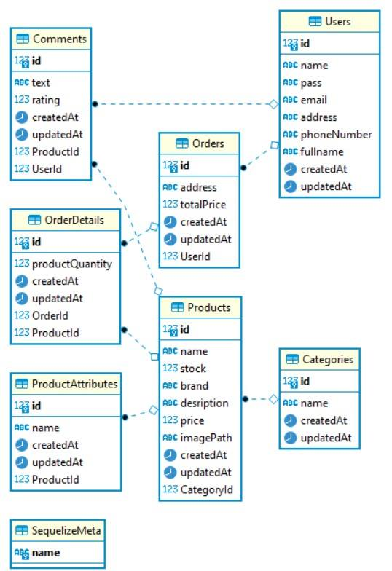
MVC (Database)

Slide 11
MVC (Payment)
Using third-party Payment API
Momo
01
POS payment
QR code payment
Zalopay
02
support user make a purchase through their ATM card.
Supporting for Vietnamese people, and have many vouchers to encourage customer/ user to buy more products.

